Slide 1

Project Wolf pack
Designers: Joel Taylor, Scott Redmond
Artist: Jay Hargraves

Slide 2

Concept
Turn-Based combat
Players party members will be different members of a wolf pack
A Grim-Dark Art style

Slide 3
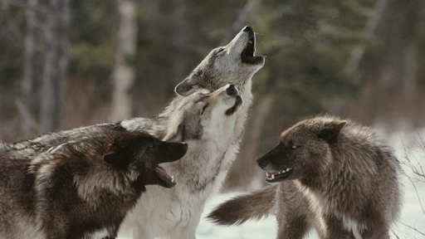
Turn-Based Combat
Classic Final Fantasy combat with a Twist
Over the course of the game your “Pack will increase”
Each member of your pack will let you acquire new attacks

Slide 4




Wolf-pack
Alpha
Beta’s
Elder

Slide 5
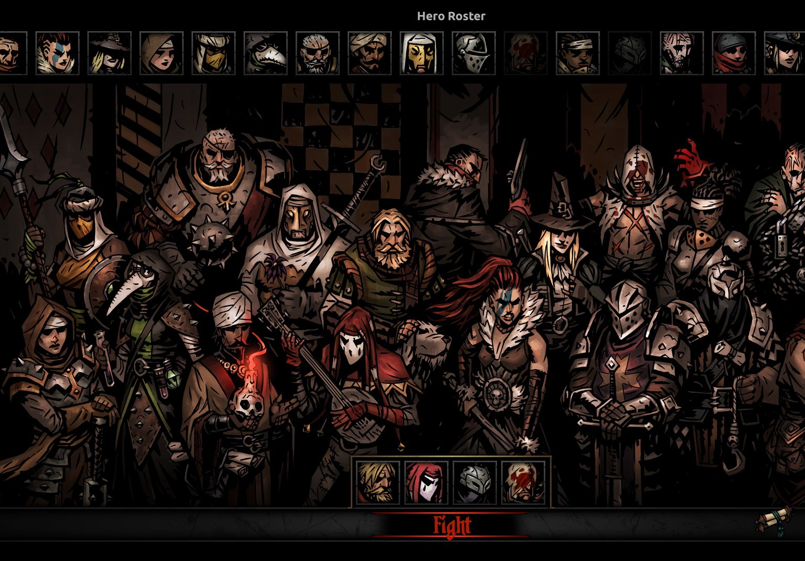
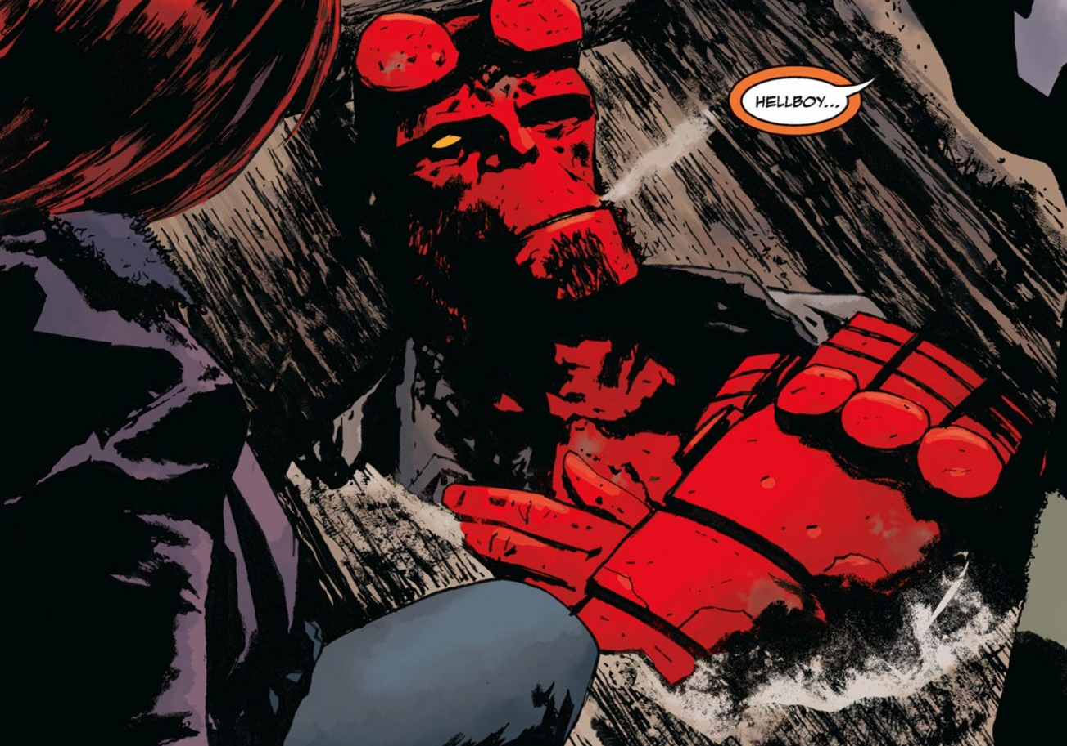
Grim-Dark

Slide 6
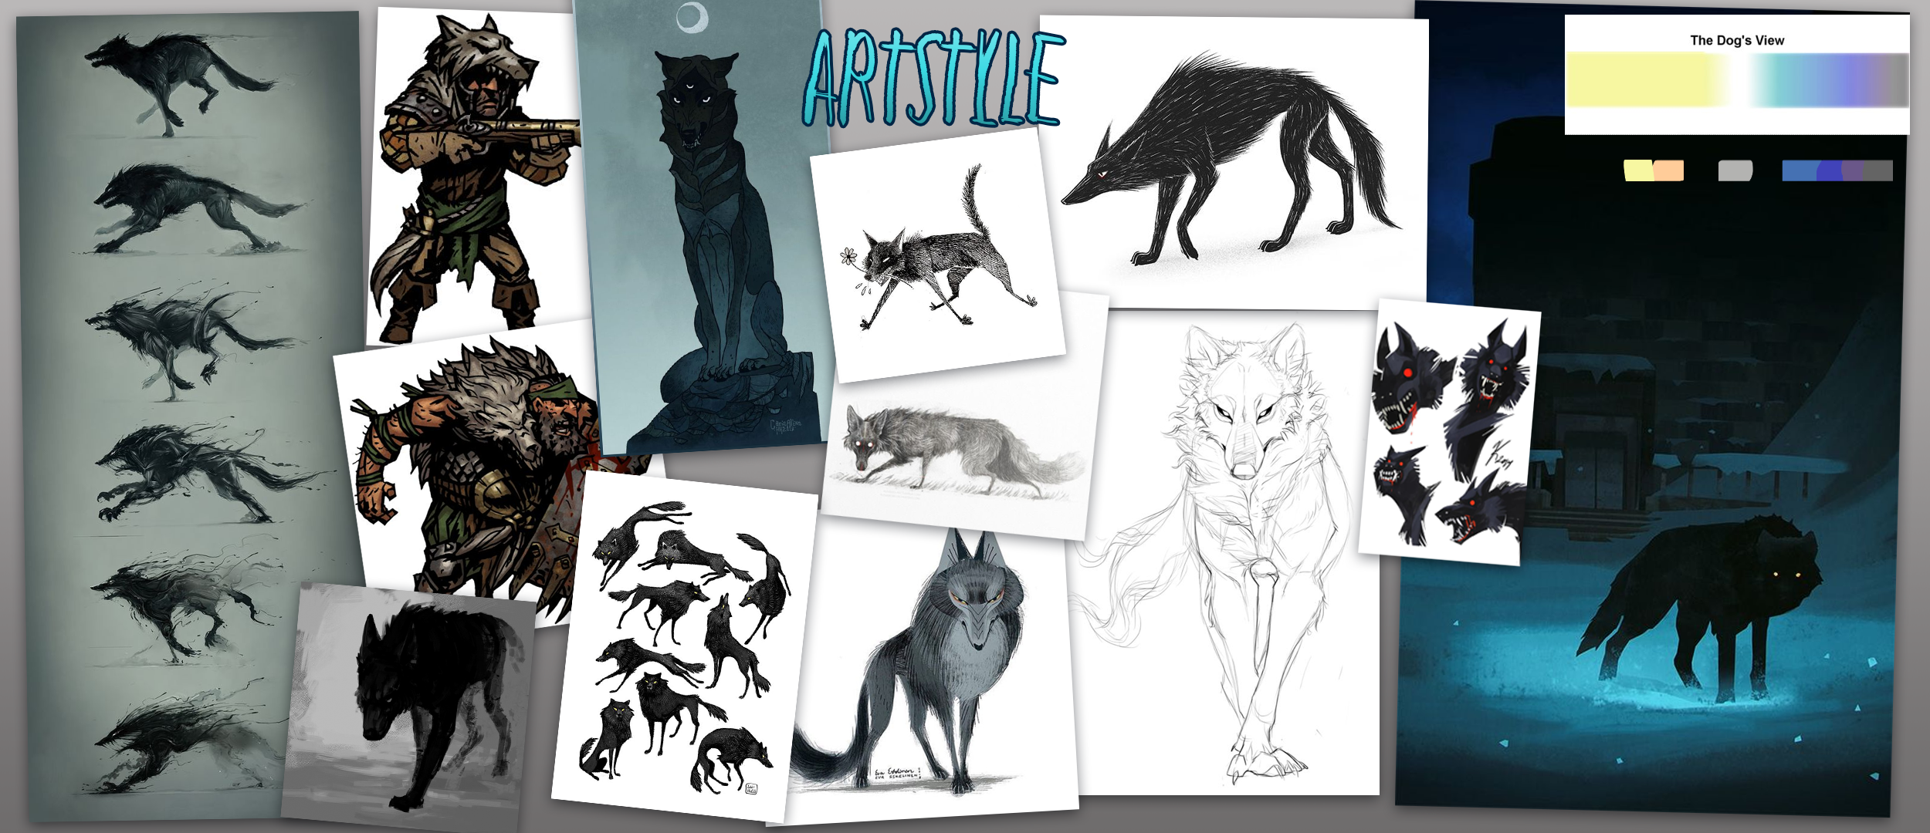

Slide 7
Questions?

